Slide 1


BTech IV Year VIII Semester Section: C
BCSE0103: SOFT COMPUTING-Genetic Algorithm(GA)
Dr. Dilip Kumar Sharma
SM(IEEE, ACM, CSI), Fellow IETE, Fellow IE(I)
Professor- Dept. of Computer Engineering & Applications
Dean (International Relations & Academic Collaborations)
GLA University, Mathura, INDIA
Email: dilip.sharma@gla.ac.in
https://www.gla.ac.in/academics/faculty-detail/7/prof-dilip-kumar-sharma

Slide 2
BCSE0103: SOFT COMPUTING- Genetic Algorithm(GA)
Genetic Algorithm(GA):Introduction to GA, Search optimization Method, Evolutionary Algorithm Working Principle, Biological Background of GA, Working Principles of GA, Encoding(Binary, Value, Permutation, Tree), Operators of GA(Random Population, Reproduction or Selection), Crossover and Mutation, Basics of Genetic Algorithm with Examples, Introduction to Genetic programming
Text Books:
S. Rajsekaran& G.A. VijayalakshmiPai, “Neural Networks, Fuzzy Logic and Genetic Algorithm: Synthesis and Applications”, 4th Edition, Prentice Hall of India,2003.

Slide 3
BCSE0103: SOFT COMPUTING
Reference Books:
Timothy J Ross ,"Fuzzy Logic with Engineering Applications", 3rd Edition, John Wiley and Sons,2016.
David E. Goldberg ,"Genetic Algorithm in Search Optimization and Machine Learning "Adission-Wesley,2009.
Karray, “Soft Computing and Intelligent Systems Design: Theory, Tools and Applications”, 1st Edition, Pearson Education,2009.
Outcome: After completion of course, student will be able to:
CO1: Understand basics of Soft Computing including Artificial Neural Networks, Fuzzy Logic and Genetic Algorithms.
CO2: Demonstrate the ability to develop some familiarity with current research problems and research methods in Soft Computing by working on a research or design project.
CO3: Understand about the fundamental theory and concepts of neural networks, neuro modeling, several neural networks paradigms and its applications.
CO4: Design and implement the concepts of knowledge using fuzzy inference systems and other machine intelligence applications.
CO5: Identify an evolutionary computing paradigm known as genetic algorithms and its applications to engineering optimization problems.

Slide 4
Background of Genetic Algorithm
First time introduced by Professor John Holland at Michigan University,USA in 1965.But,the first article on Genetic Algorithm was published in 1975.
A class of probabilistic optimization algorithms.
Inspired by the biological evolution process.
Principles of Genetic Algorithm on two fundamental biological processes:
Genetics :-Gregor Johan Mendel-1865
Evolution:-Charles Drawin-1875

Slide 5
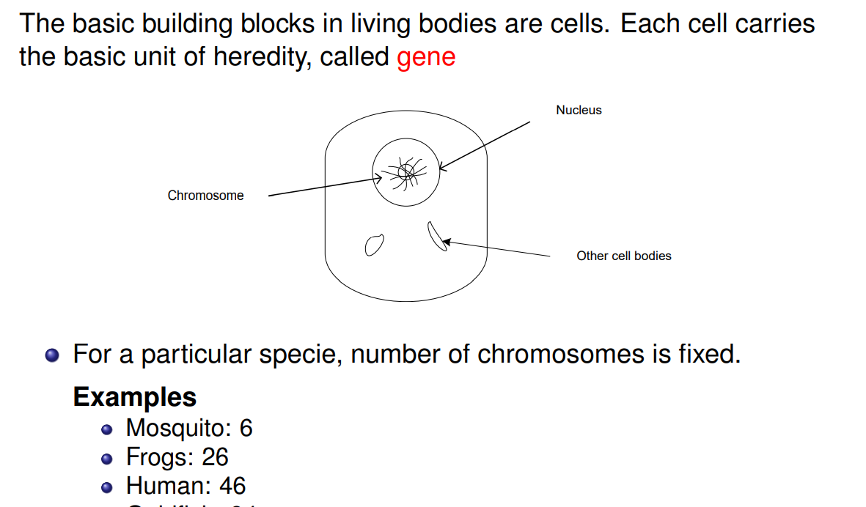
A Brief Account on Genetics

Slide 6
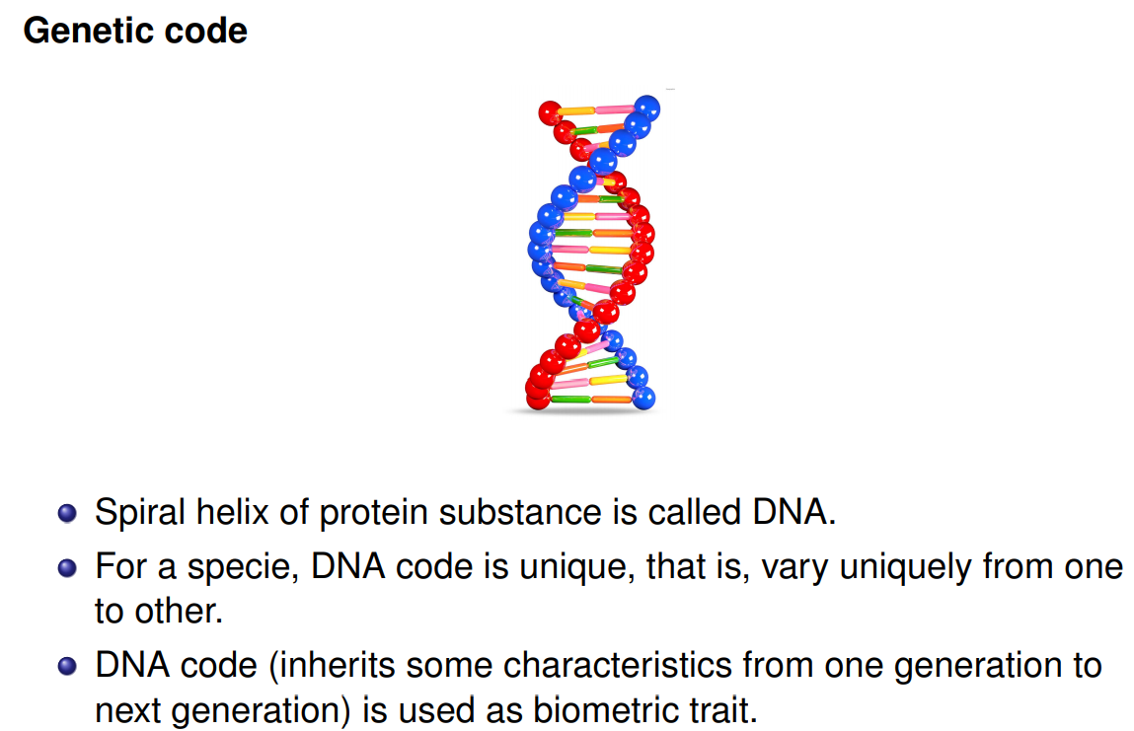
A Brief Account on Genetics:- Genetic Code
Biometric Trait:-
Face, fingerprint, hand geometry, palm print, iris, voice, signature, gait, and keystroke dynamics are examples of biometric traits. In the context of a given system and application, the presentation of a user's biometric feature involves both biological and behavioural aspects.

Slide 7
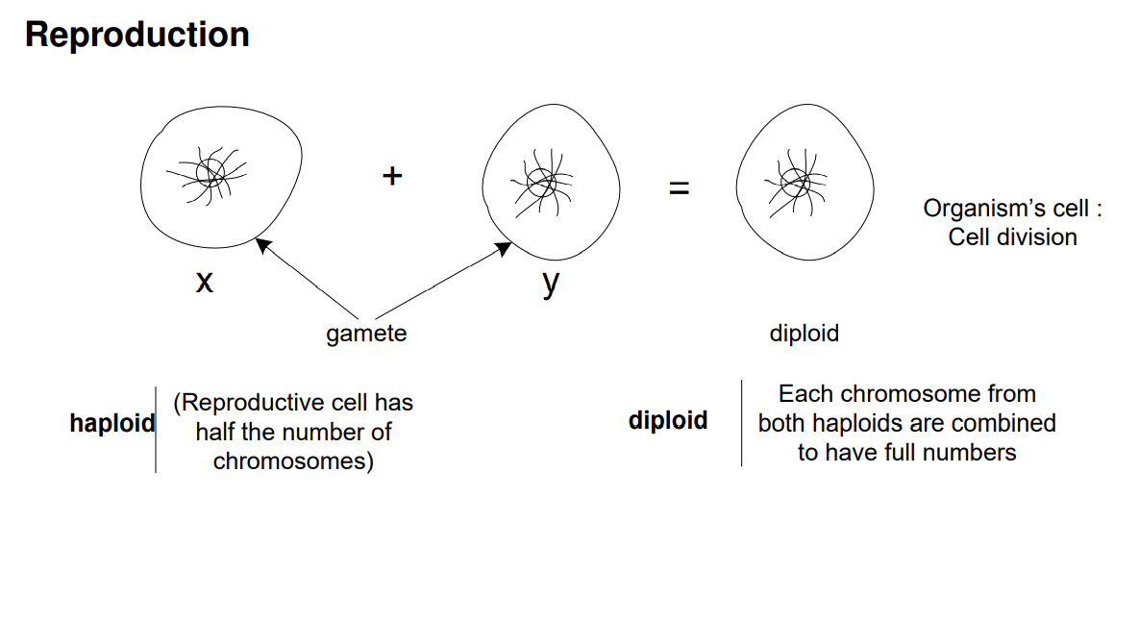
A Brief account on genetics

Slide 8
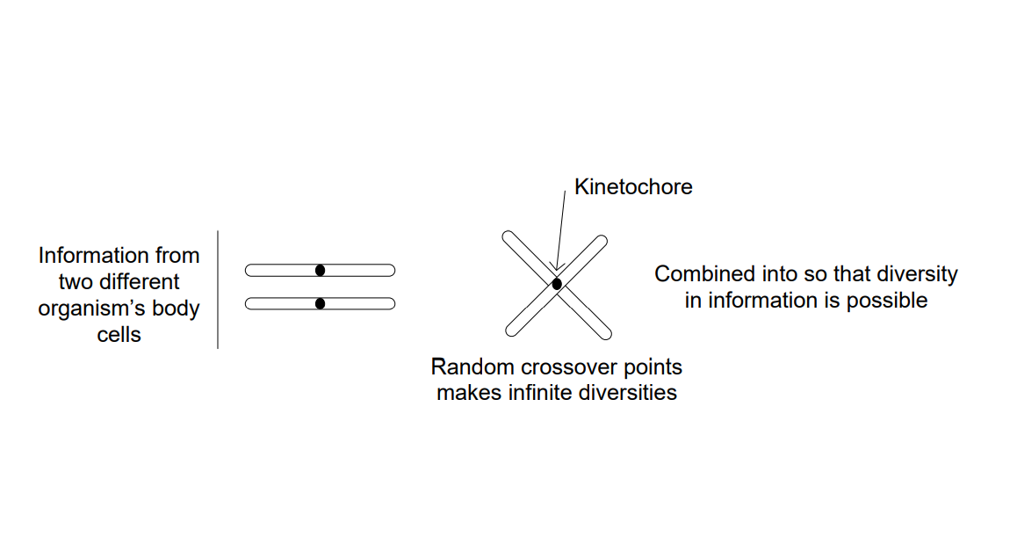
A brief account on genetics Crossing over
Crossing over is a cellular process that happens during meiosis when chromosomes of the same type are lined up. When two chromosomes — one from the mother and one from the father — line up, parts of the chromosome can be switched. The two chromosomes contain the same genes, but may have different forms of the genes.
Meiosis is a type of cell division in sexually reproducing organisms that reduces the number of chromosomes in gametes (cells, or egg ).

Slide 9
MCQ
Who is known as the “Father of Genetics”?
(a) Morgan (b) Mendel (c ) Watson (d)Bateson
Ans. (b) Mendel
Explanation:- Gregor Johann Mendel is known as the father of genetics. Genetics is the study that deals with heredity, variation, and genes in an organism.

Slide 10
MCQ
. Crossing over is ………….
(a) Cellular process (b) Molecular Process (c) Both a and B (d) None
Ans:- (a) Cellular process
Explanation:- Crossing over is a cellular process that happens during meiosis when chromosomes of the same type are lined up
.Who did introduce the Genetic Algorithm concepts?
(a) Charles Drawin (b) Gregor Johann Mendel (c) John Holland (d) All of these
Explanation:- Genetic Algorithm introduced by Professor John Holland at Michigan University,USA in 1965

Slide 11
MCQ
.Spiral helix of protein substance is known as:-
(a)DNA (b)RNA (c) Chromosomes (d)All
Ans:-(a) DNA
Explanation:-DNA is made of two linked strands that wind around each other to resemble a twisted ladder — a shape known as a double helix.
. Example of the biometric trait are….
(a) Face (b) fingerprint (c) hand geometry (d) palm print (e) All of these
Ans:-(e) All of these
Explanation:-Face, fingerprint, hand geometry, palm print, iris, voice, signature, gait, and keystroke dynamics are examples of biometric traits.

Slide 12
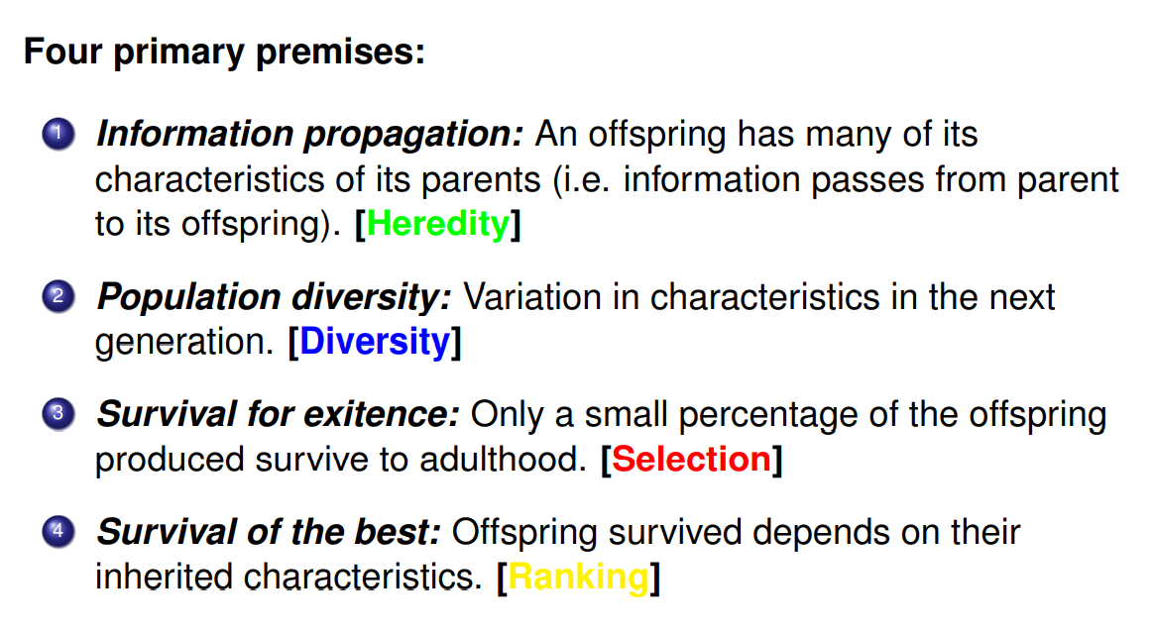
A Brief Account on Evolution : Natural Selection
RANKING

Slide 13
MCQ
The tendency of an offspring to resemble its parent is known as
(a) Variation (b) Heredity (c) Resemblance (d) Inheritance
Ans. (b) Heredity
Explanation:-Heredity, also called inheritance or biological inheritance, is the passing on of traits from parents to their offspring

Slide 14
A brief account on evolution
Mutation:
A mutation is a change in the DNA sequence of an organism. Mutations can result from errors in DNA replication during cell division, exposure to mutagens or a viral infection.
Mutation, an alteration in the genetic material (the genome) of a cell of a living organism or of a virus that is more or less permanent and that can be transmitted to the cell’s or the virus’s descendants.

Slide 15
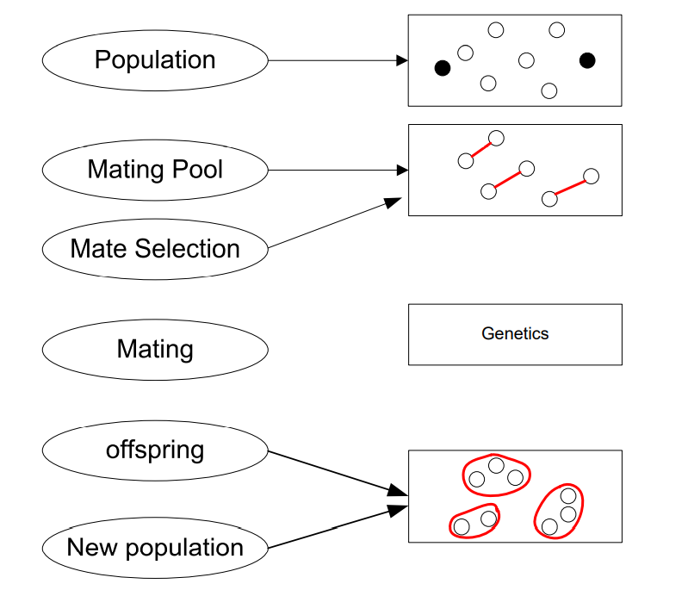
Biological process : A quick overview

Slide 16
Definition: Genetic Algorithm
Genetic algorithm is a population-based probabilistic search and optimization techniques, which works based on the mechanisms of natural genetics and natural evaluation.

Slide 17
MCQ
1.Genetic algorithm is a..
probabilistic search (b) optimization techniques
(c) adaptive heuristic search (d) All
Ans:-(d) All
Explanation:-Genetic algorithm is a population-based probabilistic search and optimization techniques and adaptive heuristic search algorithms that belong to the larger part of evolutionary algorithms.
2.Basic idea of genetic algorithm is based on….
Natural selection (b)Genetics (c) Both (d) None
Ans:- (c) Both
Explanation:- Genetic algorithms are based on the ideas of natural selection and genetics.

Slide 18
Working of Genetic Algorithm
The genetic algorithm works on the evolutionary generational cycle to generate high-quality solutions. These algorithms use different operations that either enhance or replace the population to give an improved fit solution.
There are five phases to solve the complex optimization problems, which are given as below:
(i) Initialization
(ii) Fitness Assignment
(iii) Selection
(iv) Reproduction
(v) Termination

Slide 19
Working of Genetic Algorithm
1. Initialization:-
The process of a genetic algorithm starts by generating the set of individuals, which is called population.
Here each individual is the solution for the given problem. An individual contains or is characterized by a set of parameters called Genes.
Genes are combined into a string and generate chromosomes, which is the solution to the problem.
One of the most popular techniques for initialization is the use of random binary strings.

Slide 20
Working of Genetic Algorithm
2. Fitness Assignment:-
Used to determine how fit an individual is? It means the ability of an individual to compete with other individuals.
In every iteration, individuals are evaluated based on their fitness function. The fitness function provides a fitness score to each individual.
This score further determines the probability of being selected for reproduction.
The high the fitness score, the more chances of getting selected for reproduction.

Slide 21
Working of Genetic Algorithm
3. Selection:-
The selection phase involves the selection of individuals for the reproduction of offspring.
All the selected individuals are then arranged in a pair of two to increase reproduction.
Then these individuals transfer their genes to the next generation.

Slide 22
Working of Genetic Algorithm
4. Reproduction:-
In this step, the genetic algorithm uses two variation operators that are applied to the parent population.
The two operators involved in the reproduction phase are given below:
(i) Crossover:-In this process, a crossover point is selected at random within the genes. Then the crossover operator swaps genetic information of two parents from the current generation to produce a new individual representing the offspring.

Slide 23
Working of Genetic Algorithm
(ii) Mutation:-The mutation operator inserts random genes in the offspring (new child) to maintain the diversity in the population. It can be done by flipping some bits in the chromosomes. Mutation helps in solving the issue of premature convergence and enhances diversification.
5. Termination:-After the reproduction phase, a stopping criterion is applied as a base for termination. The algorithm terminates after the threshold fitness solution is reached. It will identify the final solution as the best solution in the population.
**A diversity in population is a group of people who differ in terms of one of more characteristics, such as by gender, age, class and ethnicity.

Slide 24
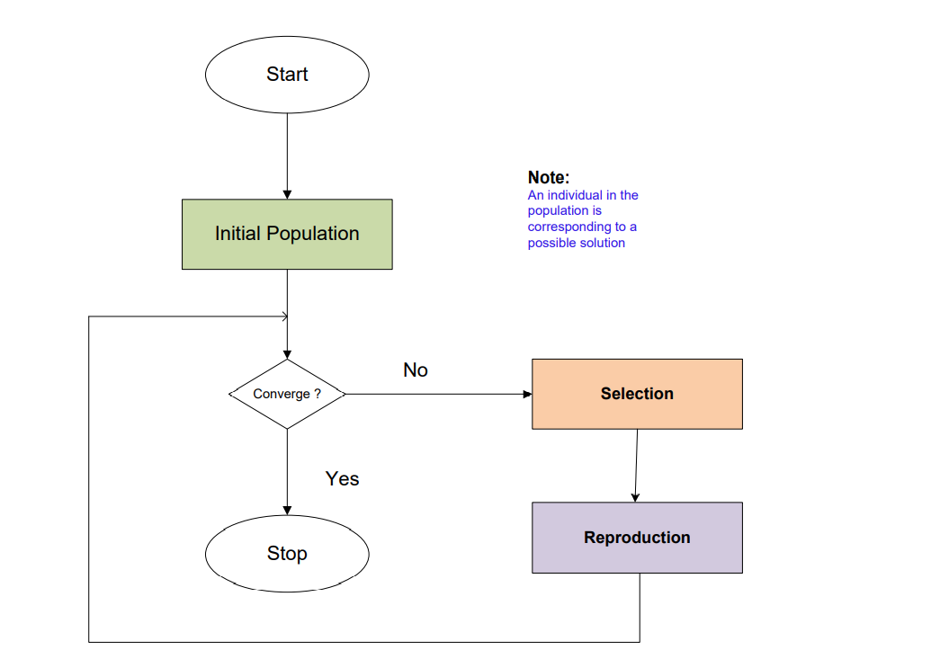
Framework of Genetic Algorithm

Slide 25
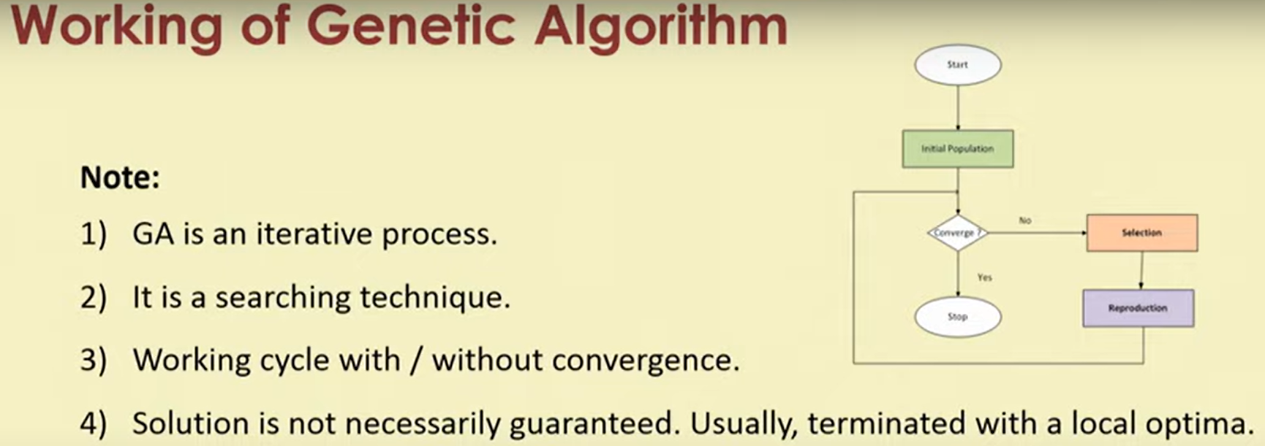

Slide 26
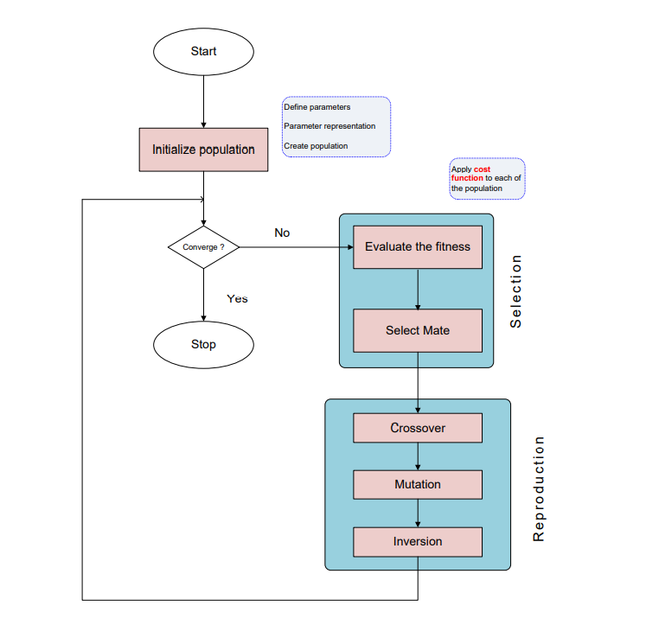
Framework of Genetic Algorithm: A detail view

Slide 27
MCQ
1.Basic steps of working of the genetic algorithm are:-
(i) Initialization, Fitness Assignment (ii) Fitness Assignment , Selection
(iii)Reproduction ,Termination (iv) All
Ans:- (iv) All
Explanation:-There are five phases to solve the complex optimization problems using genetic algorithm, which are given as below: (i) Initialization (ii) Fitness Assignment (iii)Selection (iv)Reproduction (v)Termination
2. Inserting random genes in the offspring to maintain the diversity in the population is known as:-
(i)Fitness assignments (ii)Selection (iii)Mutation (iv) All
Ans:- (iii) Mutation
Explanation:- The mutation operator inserts random genes in the offspring (new child) to maintain the diversity in the population. It can be done by flipping some bits in the chromosomes.

Slide 28
MCQ
3. A crossover point is selected within the genes, how?
(i) Randomly (ii) Linearly (iii)Only First (iv)All
Ans: (i) Randomly
Explanation:- A crossover point is selected at random within the genes.
4.In the reproduction phase of genetic algorithm, we use…
(i)Mutation (ii)crossover (iii)selection (iv)both i & ii
Ans:- (iv) Both i & ii
Explanation:-In the reproduction phase ,we use the mutation and crossover

Slide 29
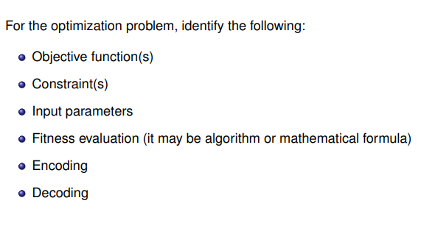
Optimization problem solving with Genetic Algorithm

Slide 30
Optimization problem solving with Genetic Algorithm
Objective function:
Constraints:
Input Parameters:
Fitness Function:
It takes the chromosome as input, then produces a result that quantifies how good that chromosome is.
Computes the values of all the inequality and equality constraints
PM-Probability of a mutation
PC-Probability crossover
N- a population size.
Also known as the Evaluation Function that evaluates how close a given solution is to the optimum solution of the desired problem.

Slide 31
Optimization problem solving with Genetic Algorithm
Encoding: In genetic algorithm, an encoding function is use to represent mapping of the object variables to a string code and mapping of string code to its object variable is achieve through decoding function.
Decoding: It is a process of transforming a solution from the genotype to the phenotype space.
Genotype: The set of genes representing the chromosome.
Phenotype: The actual physical representation of the chromosome.

Slide 32
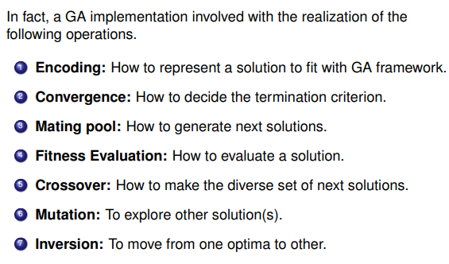
Genetic Algorithm Operators

Slide 33
Different Genetic Algorithm Strategies
Simple Genetic Algorithm.
Steady State Genetic Algorithm.
Messy State Genetic Algorithm.

Slide 34
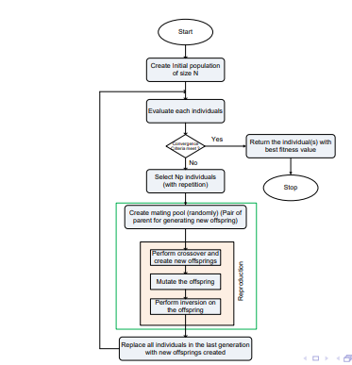
Simple GA

Slide 35
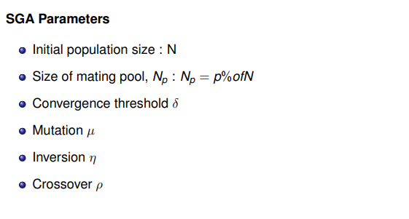
Important parameters involved in Simple GA

Slide 36
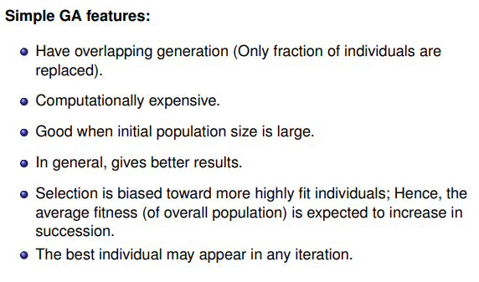
Features of Simple GA

Slide 37
Applications :Simple Genetic Algorithm
1.Learning robot behavior using Simple Genetic Algorithm.
2.In the finance industry.
3.Neural networks.
4.Soft computing Applications like Fuzzy logic, Neurocomputing.
5. Optimization problems.

Slide 38
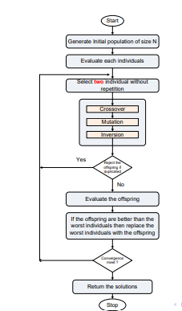
Steady State Genetic Algorithm (SSGA)

Slide 39
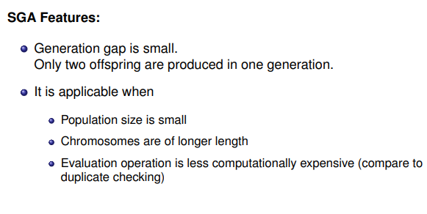
Salient features in Steady-state GA

Slide 40
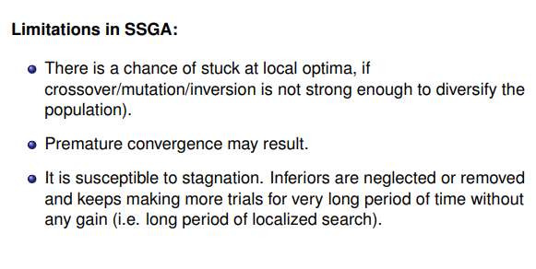
Limitations in Steady-state GA

Slide 41

Application:Steady-state GA
To optimize a wide range of different fit functions which is not solvable using normal hard computing-based algorithms.
Distributed computer network topologies.
Learning fuzzy rule base using genetic algorithms.
In training neural networks using SSGA instead of normal Backprop algorithms and many more.

Slide 42
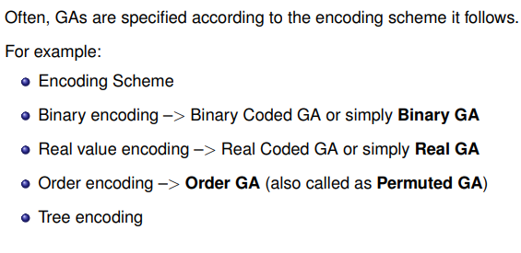
Encoding Schemes in GA

Slide 43
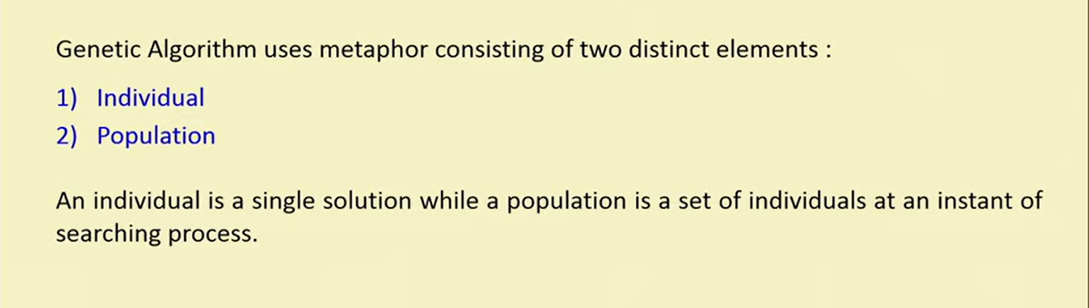
Encoding Schemes in GA

Slide 44
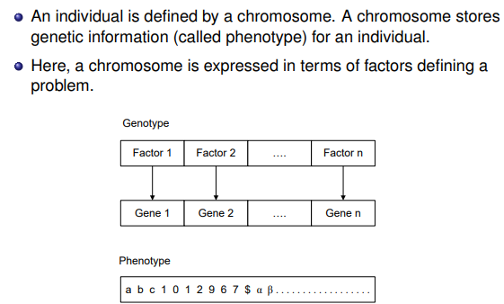
Individual Representation :Phenotype and Genotype

Slide 45
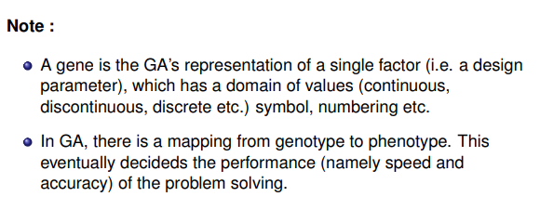
Individual Representation :Phenotype and Genotype

Slide 46
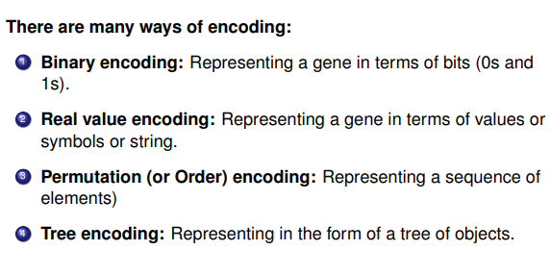
Encoding techniques

Slide 47
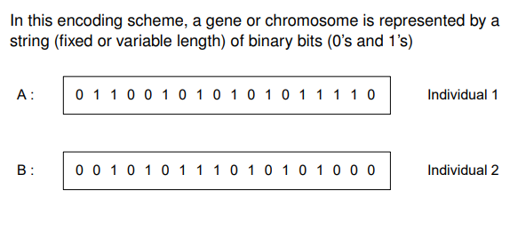
Binary Encoding

Slide 48
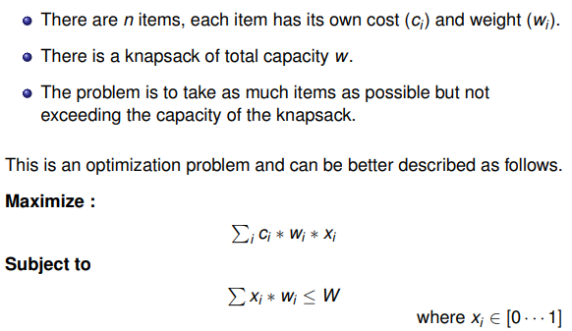
Example: 0-1 Knapsack problem

Slide 49
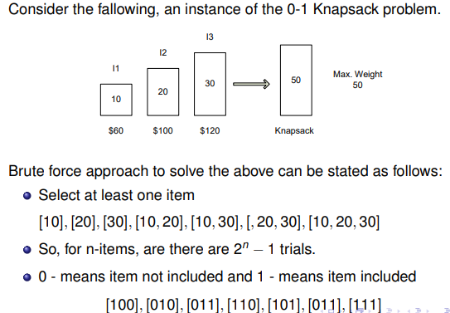
Example: 0-1 Knapsack problem

Slide 50
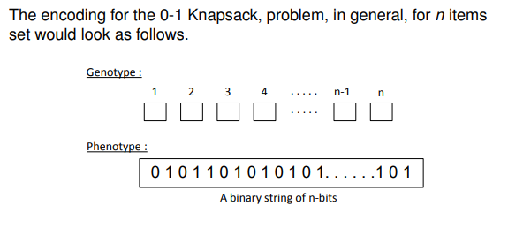
Example: 0-1 Knapsack problem

Slide 51
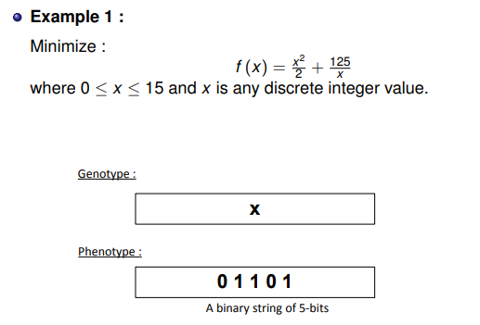
Few more examples
OBJECTIVE FUNCTION
At x=0, f(0)=Infinite
At x=1,f(1)=125.5
At x=2,f(2)=64.5
.
.
At x=5,f(5)=37.5(Minimum)
.
.
.
.
So (5)2 =(0101)
0101

Slide 52
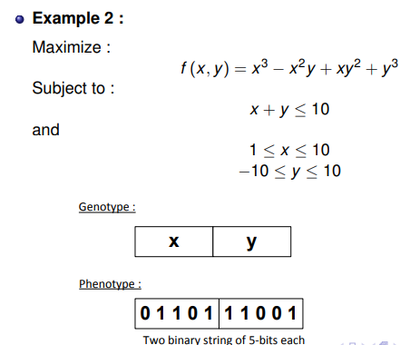
Few more examples
X = 10
Y = -1
01010
10001

Slide 53
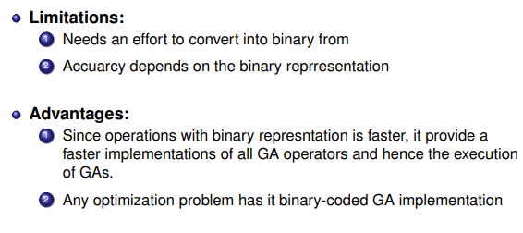
Pros and cons of Binary encoding scheme

Slide 54
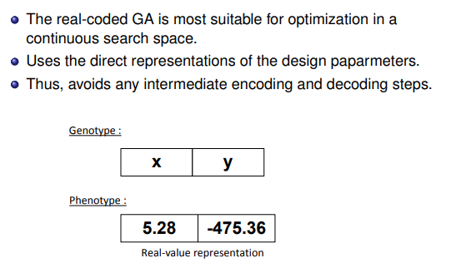
Real value encoding

Slide 55
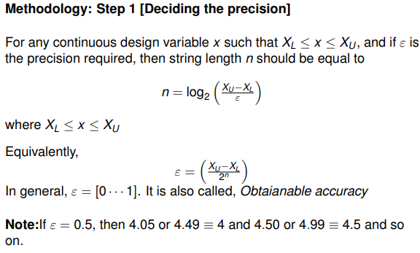
Real value encoding with binary codes
Gives the number of binary digits that required for real value

Slide 56
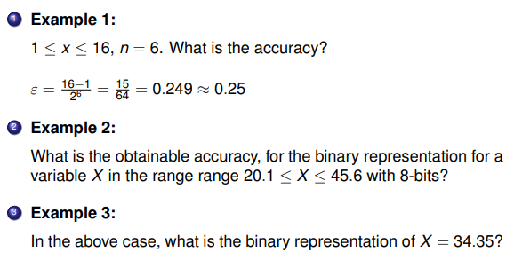
Real value encoding: Illustration 1
X L=20.1 ,XU=45.6 and n=6
Then ɛ=(46.6-20.1)/2^8
=.41

Slide 57
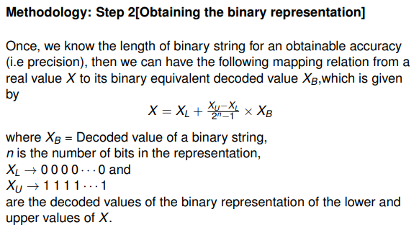
Real value encoding with binary codes

Slide 58
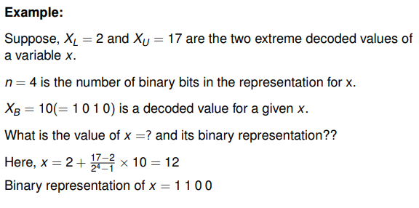
Real value encoding: Illustration 2

Slide 59
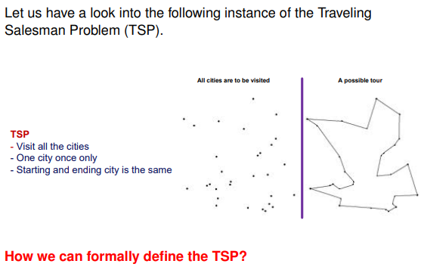
Order Encoding

Slide 60
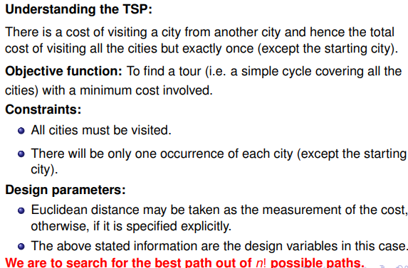
Order Encoding for TSP

Slide 61
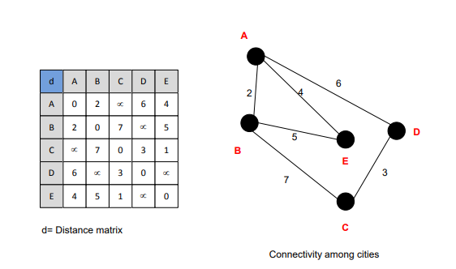
A small instance of the TSP

Slide 62
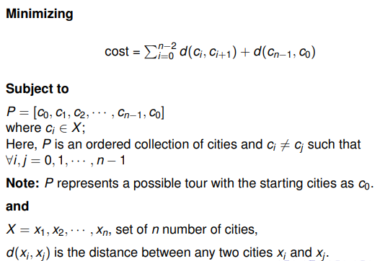
Defining the TSP

Slide 63
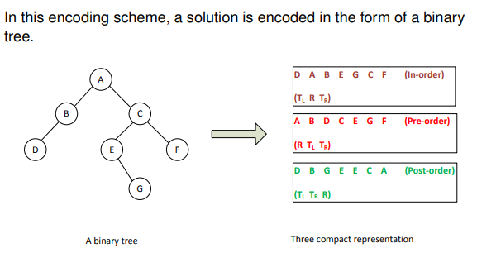
Tree encoding

Slide 64
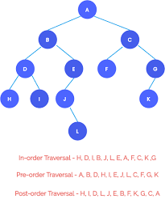
Tree Coding: Example

Slide 65
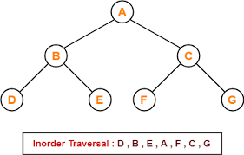
MCQ
1.Tree Encoding is a…
(i)A solution is encoded in binary tree form (ii)A solution is encoded in list form
(iii) A solution is encoded in array form (iv) All
Ans:-(i)
2.What is sequence of In-order in given tree using tree encoding?
(i) B,D,A,E,F,C,G
(ii) D,B,A,E,F,C,G
(iii)D,B,E,A,F,C,G
(iv)D,B,E,A,F,C,G
Ans: - (iv)D,B,E,A,F,C,G

Slide 66
Selection Schemes in Genetic Algorithm
It is the process of creating the population for next generation from the current generation.
Selection is the stage of a genetic algorithm in which individual genomes or chromosomes are chosen from a population for later breeding i.e. the fittest individuals are selected for reproduction in order to produce offspring of the next generation.
“Selects the best, discards the rest”
Mainly we discuss on two things:-
1.How to choose the individual in the population that will create OFFSPRING for the next generation?
2.How many OFFSPRING each will create?

Slide 67
Selection Schemes in Genetic Algorithm
To generate new population:-
(i) Create a mating Pool
(ii) Select a pair
(iii)Reproduce

Slide 68
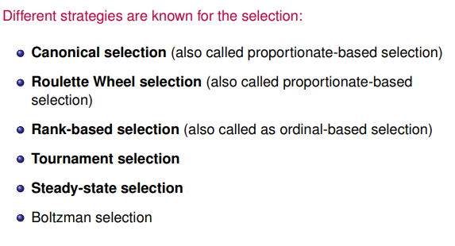
Selection Schemes in Genetic Algorithm
Elitist Selection

Slide 69
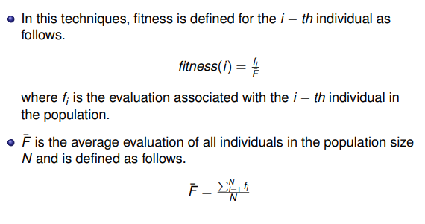
Canonical Selection
n
=(fi /Σ i=1 fi) X N

Slide 70
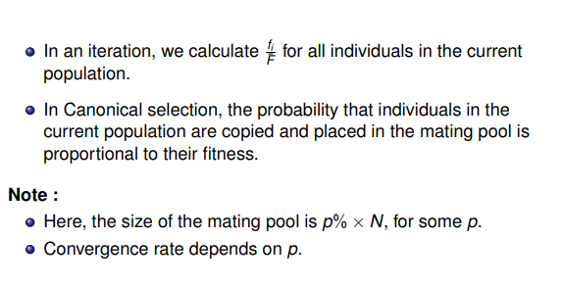
Canonical Selection

Slide 71
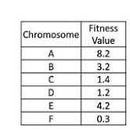
Canonical Selection: Example
n
fitness(i)=(fi /Σ i=1 fi) X N
=(8.2+3.2+1.4+1.2+4.2+.3)/6=18.5/6=3.08
Then
fitness(A)=fA / =8.2/3.08=2.66
fitness(B)=fB / =3.2/3.08=1.04
fitness(C)=f C / =1.4/3.08=.45
fitness(D)=fD / =1.2/3.08=.38
fitness(E)=fE / =4.2/3.08=1.36
fitness(F)=fF / =.3/3.08=.1
Mating Pool (Pick 50% of N)
Chromosome | Current Fitness Value
A | 2.66
E | 1.36
B | 1.04

Slide 72
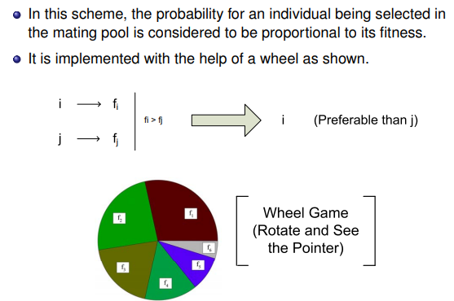
Roulette-Wheel selection

Slide 73
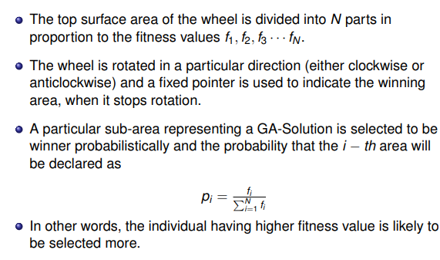
Roulette-Wheel selection mechanism

Slide 74
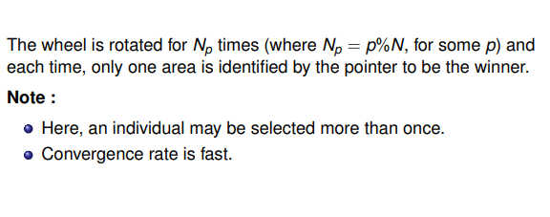
Roulette-Wheel selection mechanism

Slide 75
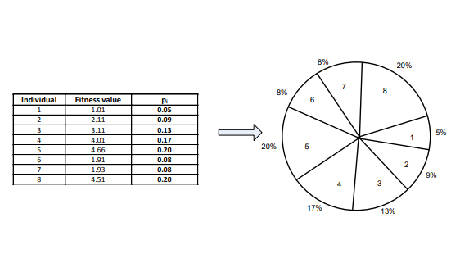
Roulette-Wheel selection mechanism: An Example
.04
Ʃfi=23.25

Slide 76
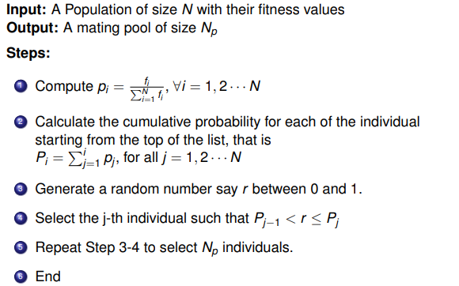
Roulette-Wheel selection : Implementation

Slide 77

Roulette-Wheel selection : Implementation

Slide 78

Problem with Roulette-Wheel selection scheme

Slide 79

Rank-based selection

Slide 80

Rank-based selection: Example

Slide 81

Rank-based selection: Implementation

Slide 82

Comparing Rank-based selection with Roulette-Wheel selection

Slide 83

Basic concept of tournament selection

Slide 84

Tournament selection

Slide 85

Tournament selection : Implementation

Slide 86

Tournament selection : Example

Slide 87
MCQ
1.Which is not a selection method in genetic algorithm
Rank Selection (ii) Tournament Selection
(iii) Roulette Wheel Selection (iv)Additive Method
Ans:-(iv)Additive Method
2.In which selection method the parent section pressure is exist.
Rank Selection (ii) Tournament Selection
(iii) Roulette Wheel Selection (iv)Canonical
Ans:- (iii) Roulette Wheel Selection

Slide 88
Crossover Technique
It is also called recombination. It is a genetic operator used to combine the genetic information of two parents to generate new offspring.
Crossover is a genetic operator used to vary the programming of a chromosome or chromosomes from one generation to the next.
Crossover is sexual reproduction. Two strings are picked from the mating pool at random to crossover in order to produce superior offspring. The method chosen depends on the Encoding Method.

Slide 89

Crossover Techniques in Binary Coded GA

Slide 90

Single point crossover

Slide 91

Single point crossover: Illustration

Slide 92

Two-point crossover

Slide 93

Two-point crossover: Illustration

Slide 94

Multi-point crossover

Slide 95

Uniform Crossover (UX)

Slide 96

Uniform crossover (UX): Illustration
If the toss is 1 ,does not swap bits

Slide 97

Uniform crossover with crossover mask
Crossover mask: It is a bit string of length n, which determines the parent that contributes each bit. Generally, for each bit in offspring 1, a 0 in the corresponding position of the crossover mask will mean that the bit is taken from parent 1, while a 1 will mean that the bit is taken from parent 2.

Slide 98

Uniform crossover with crossover mask: Illustration
0

Slide 99

Half-uniform crossover (HUX)

Slide 100

Half-uniform crossover: Illustration

Slide 101

Shuffle crossover

Slide 102

Shuffle crossover: Illustration

Slide 103
MCQ
1.Which crossover method is not exist in genetic algorithm.
(i)Single (ii)Multi (iii)Uniform (iv)Random
Ans:- (iv)Random
2.Which mutation method is best for binary encoding.
(i)Single (ii)Multi (iii)Uniform (iv)Bit Flipped
Ans:-(iv)Bit Flipped
3. Genetic operators includes:- (A) Crossover (B) Mutation (C) Both A & B (D) None of these
Ans:- (C) Both A & B

Slide 104
MCQ
3.Produces two new offspring from two parent string by copying selected bits from each parent is called (A) Mutation (B) Inheritance (C) Crossover (D) None of these
Ans:- (C) Crossover

Slide 105
Mutation
Mutation Operator is a unary operator and it needs only one parent to work on. It does so by selecting a few genes from our selected chromosome and apply the desired algorithm.
In GA ,there are five Mutation Algorithms for string manipulation – 1) Bit Flip Mutation 2) Random Resetting Mutation 3) Swap Mutation 4) Scramble Mutation 5) Inversion Mutation

Slide 106
Mutation Algorithm:
Bit Flip Mutation
Bit Flip Mutation is mainly used for bit string manipulation while others can be used for any kind of strings. Here our chromosome will be represented as an array and each index will represent one gene. Strings can be represented as an array of characters which in turn is an array of ASCII or numeric values. In bit flip mutation, we select one or more genes (array indices) and flip their values i.e. we change 1s to 0s and vice versa. It is better explained using the given diagram.

Slide 107
Mutation Algorithm:
Random Resetting Mutation
In random resetting mutation, we select one or more genes (array indices) and replace their values with another random value from their given ranges. Let’s say a[i] (an array index / gene) ranges from [1, 6] then random resetting mutation will select one value from [1, 6] and replace a[i]’s value with it.

Slide 108

Mutation Algorithm:
Swap Mutation
In Swap Mutation we select two genes from our chromosome and interchange their values.

Slide 109

Mutation Algorithm: Scramble Mutation
In Scramble Mutation we select a subset of our genes and scramble their value. The selected genes may not be contiguous (see the second diagram).
.

Slide 110

Mutation Algorithm:
Inversion Mutation
In Inversion Mutation we select a subset of our genes and reverse their order. The genes have to be contiguous in this case (see the diagram).

Slide 111
MCQ
1.Mutation is a/an..
(i)Unary Operator (ii)Binary Operator (iii) Ternary Operator (iv)None of these
Ans:- (i)Unary Operator
2.Which is the type of mutation.
(i)Single (ii)Multi (iii)Rank (iv) Bit Flip
Ans:-(iv) Bit Flip

Slide 112
MCQ
3.Which is the example of swap mutation.
(i)
(ii)
(iii)
(iv) All

Slide 113
MCQ
4.Applying recombination and mutation leads to a set of new candidates, called as?
(i) Sub Parents (ii)Parents (iii) Offspring (iv) Grand child
Ans:-(iii) Offspring
5.A mutation operator works on ….
(i)Only One Parent (ii)Two Parent (iii)Group of Parent (iv)None of these
Ans:- (i) Only One parent

Slide 114

Genetic Algorithm with example

Slide 115
Genetic Algorithm with example
Genetic algorithms find use in various real-world applications.
1.Neural networks:-We use it for ‌genetic optimization in neural networks or use cases like inheriting qualities of neurons, neural network pipeline optimization, finding the best fit set of parameters for a given neural network, and others.
2. Data mining and clustering:-Data mining and clustering use genetic algorithms to find out the centre point of the clusters with an optimal error rate given to its great searching capability for an optimal value. It is renowned as an unsupervised learning process in machine learning, where we categorize the data based on the characteristics of the data points.
3. Image processing:-Image processing tasks, such as image segmentation, are one of the major use cases of genetic optimization.

Slide 116
Genetic Algorithm with example
4. Wireless sensor network:-WSN utilizes genetic machine learning to stimulate the sensors. We can optimize and even customize all the operational stages with the help of the fitness function from genetic algorithms in wireless sensor networks.
5. Traveling salesman problem (TSP):-TSP is one of the real-life combinatorial optimization problems that were solved using genetic optimization. It helps in finding an optimal way in a given map with the distance between two points and with the routes to be covered by the salesman. It finds application in real-time processes like planning, manufacturing and logistics.
6. Vehicle routing problems:-Genetic algorithms help in finding the optimal weight of goods to be delivered through the optimal set of delivery routes. Factors such as depot points, wait, distance are taken into consideration while solving such problems if they have any kind of restrictions. Moreover, the genetic algorithm approach is competitive in terms of solution quality and time with simulated annealing algorithms and tabu search.

Slide 117
Genetic Algorithm with example
7. Mechanical engineering design:-Genetic algorithm example where the aircraft wing design is a kind of designing problem that takes multiple disciplines into consideration. It requires improvement in the ratio of left to drag for a complex wing. The fitness function in genetic optimization is flexible to considerations that come as a demand for a particular design.
8. Manufacturing system:-The manufacturing arena includes various examples of the cost function. Based on the same, the need to find an optimal set of parameters for such functions poses a problem.Genetic optimization performs this task of using the optimized set of parameters to minimize the cost function. It also finds application in product manufacturing to achieve optimum production plans by considering dynamic conditions like capacity, inventories, or material quality.

Slide 118
Genetic Algorithm with example
9. Financial markets:-A variety of issues can be solved using genetic optimization in the financial market. It helps in finding an optimal combination of parameters that can affect the trades or market rules.
10. Medical science:-Medical signs have an array of use cases for genetic optimization. The areas of predictive analysis include protein prediction, RNA structure prediction, operon prediction, and others. Other processes such as protein folding, gene expression profiling analysis, bioinformatics multiple sequence alignment, or some of the process alignment that uses genetic optimisation.
11. Task scheduling:-Genetic machine learning algorithms are used to derive optimal schedules that satisfy certain constraints related to a problem. For instance: assume that you have to prepare the schedule for the semester exams for University. The genetic algorithm will find the best optimal schedule for the university considering all the constraints like the number of classrooms, the number of students, the total number of courses and subjects, and others.

Slide 119
Genetic Algorithm with example
12. Economics: Economics is the study of resource utilization in the production, distribution, and complete consumption of goods and services over a time period. The genetic algorithm creates models of demand and supply that derive asset pricing, game theory, and others.
13. Robotics: Robotics comprises the construction, design, and working of the autonomous robot. Genetic algorithms contribute to the robotics field by providing the necessary insight into the decisions made by the robot. It generates optimal routes for the robot so that it can use the least amount of resources to get to the desired position.

Slide 120
Introduction to genetic programming
Genetic programming is a specialization of genetic algorithms where each individual is a computer program.
Genetic Programming(or GP) introduced by Mr. John Koza.
Genetic programming is a systematic method for getting computers to automatically solve a problem and iteratively transform a population of computer programs into a new generation of programs by applying analogs of naturally occurring genetic operations.

Slide 121

Fuzzy Logic Control
The following diagram shows the architecture of Fuzzy Logic Control (FLC).

Slide 122
Major Components of FLC
Followings are the major components of the FLC as shown in the above figure −
Fuzzifier − The role of fuzzifier is to convert the crisp input values into fuzzy values.
Fuzzy Knowledge Base − It stores the knowledge about all the input-output fuzzy relationships. It also has the membership function which defines the input variables to the fuzzy rule base and the output variables to the plant under control.
Fuzzy Rule Base − It stores the knowledge about the operation of the process of domain.
Inference Engine − It acts as a kernel of any FLC. Basically it simulates human decisions by performing approximate reasoning.
Defuzzifier − The role of defuzzifier is to convert the fuzzy values into crisp values getting from fuzzy inference engine.

Slide 123
Steps in Designing FLC
Following are the steps involved in designing FLC −
Identification of variables − Here, the input, output and state variables must be identified of the plant which is under consideration.
Fuzzy subset configuration − The universe of information is divided into number of fuzzy subsets and each subset is assigned a linguistic label. Always make sure that these fuzzy subsets include all the elements of universe.
Obtaining membership function − Now obtain the membership function for each fuzzy subset that we get in the above step.
Fuzzy rule base configuration − Now formulate the fuzzy rule base by assigning relationship between fuzzy input and output.
Fuzzification − The fuzzification process is initiated in this step.
Combining fuzzy outputs − By applying fuzzy approximate reasoning, locate the fuzzy output and merge them.
Defuzzification − Finally, initiate defuzzification process to form a crisp output.

Slide 124


Slide 125


Slide 126


Slide 127
Tree Encoding Problems

Slide 128

Problem 1

Slide 129

Problem 2

Slide 130

Problem 3---(For Students)
1234567
1234567
1234567

Slide 131
Tournament selection Problem

Slide 132

Problem 1

Slide 133

Problem 2

Slide 134
Question:
Suppose a genetic algorithm uses chromosomes of the form
x = abcdef gh with a fixed length of eight genes. Each gene can be any digit between 0 and 9. Let the fitness of individual x be calculated as: f (x) = (a + b) − (c + d) + (e + f ) − (g + h) ,
and let the initial population consist of four individuals with the following chromosomes: x1 = 6 5 4 1 3 5 3 2 x2 = 8 7 1 2 6 6 0 1 x3 = 2 3 9 2 1 2 8 5 x4 = 4 1 8 5 2 0 9 4

Slide 135
Evaluate the fitness of each individual, showing all your workings, and arrange them in order with the fittest first and the least fit last. Answer: f (x1) = (6 + 5) − (4 + 1) + (3 + 5) − (3 + 2) = 9 f (x2) = (8 + 7) − (1 + 2) + (6 + 6) − (0 + 1) = 23 f (x3) = (2 + 3) − (9 + 2) + (1 + 2) − (8 + 5) = −16 f (x4) = (4 + 1) − (8 + 5) + (2 + 0) − (9 + 4) = −19
The order is x2, x1, x3 and x4.

Slide 136
b) Perform the following crossover operations: i) Cross the fittest two individuals using one–point crossover at the middle point. Answer: One–point crossover on x2 and x1: x2 = 8 7 1 2 6 6 0 1 x1 = 6 5 4 1 3 5 3 2
O1 = 8 7 1 2 3 5 3 2 O2 = 6 5 4 1 6 6 0 1 ii) Cross the second and third fittest individuals using a two–point crossover (points b and f ). Answer: Two–point crossover on x1 and x3 x1 = 6 5 4 1 3 5 3 2 x3 = 2 3 9 2 1 2 8 5
O3 = 6 5 9 2 1 2 3 2 O4 = 2 3 4 1 3 5 8 5

Slide 137
iii) Cross the first and third fittest individuals (ranked 1st and 3rd) using a uniform crossover.
Answer: In the simplest case uniform crossover means just a random exchange of genes between two parents. For example, we may swap genes at positions a, d and f of parents x2 and x3: x2 = 8 7 1 2 6 6 0 1 x3 = 2 3 9 2 1 2 8 5
O5 = 2 7 1 2 6 2 0 1 O6 = 8 3 9 2 1 6 8 5

Slide 138
c) Suppose the new population consists of the six offspring individuals received by the crossover operations in the above question. Evaluate the fitness of the new population, showing all your workings. Has the overall fitness improved? Answer: The new population is: O1 = 8 7 1 2 3 5 3 2 O2 = 6 5 4 1 6 6 0 1 O3 = 6 5 9 2 1 2 3 2 O4 = 2 3 4 1 3 5 8 5 O5 = 2 7 1 2 6 2 0 1 O6 = 8 3 9 2 1 6 8 5 Now apply the fitness function f (x) = (a+b)−(c+d)+(e+f )−(g+h): f (O1) = (8 + 7) − (1 + 2) + (3 + 5) − (3 + 2) = 15 f (O2) = (6 + 5) − (4 + 1) + (6 + 6) − (0 + 1) = 17 f (O3) = (6 + 5) − (9 + 2) + (1 + 2) − (3 + 2) = −2 f (O4) = (2 + 3) − (4 + 1) + (3 + 5) − (8 + 5) = −5 f (O5) = (2 + 7) − (1 + 2) + (6 + 2) − (0 + 1) = 13 f (O6) = (8 + 3) − (9 + 2) + (1 + 6) − (8 + 5) = −6 The overall fitness has improved.

